Slide 1

THE dIGITAL WALLET OF BANGLADESH
Name : Sania Fardushe Juthi
Department: Economics
Batch no: 21
Id no : 20

Slide 2
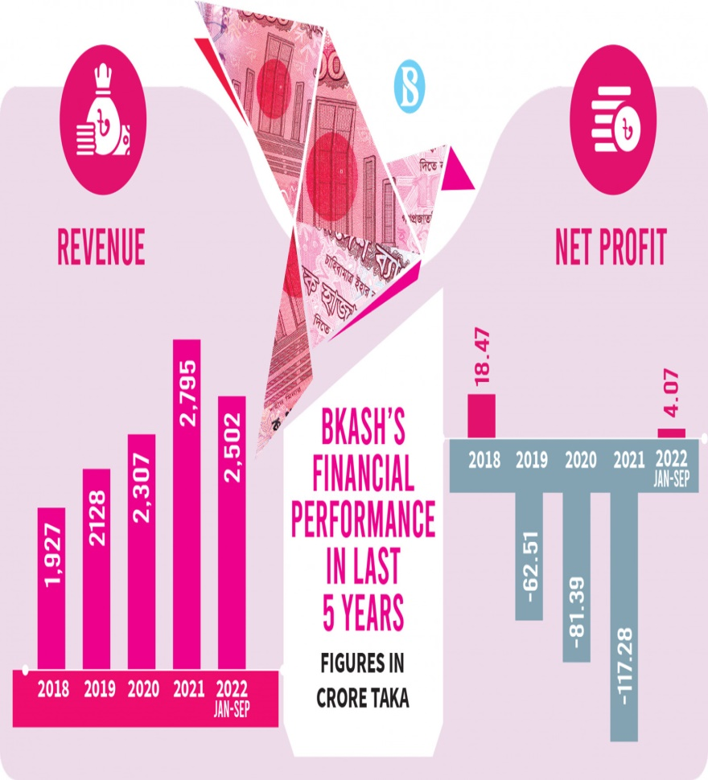
INTRODUCTION
bKash is a mobile financial service launched in 2011 by BRAC Bank in Bangladesh . It allows users to conduct financial transactions easily through their mobile phones.
To enhance financial inclusion and improve the living standards of people in Bangladesh by providing accessible financial services.
Over 50 million registered users as of 2023, showcasing its extensive reach and acceptance.

Slide 3




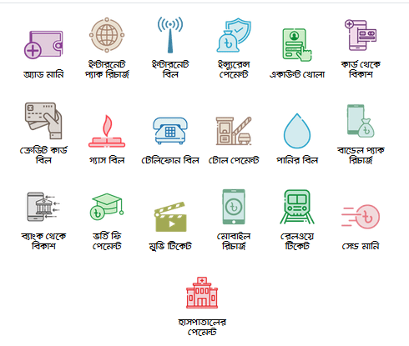
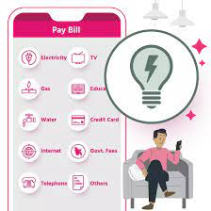
PRODUCT & SERVICES
1. Cash-in and Cash-out Services : Users can deposit money into their bKash accounts through agents and withdraw cash from the same.
2. Mobile Top-ups : Instant recharge options available for various mobile networks.
3. Utility Bill Payments : Pay utility bills (electricity, gas, water) conveniently through the app.
4. Merchant Payments : Facilitates payments to a vast network of merchants across the country.
5. Secure Transactions : Uses state-of-the-art encryption and security protocols to ensure user safety.

Slide 4
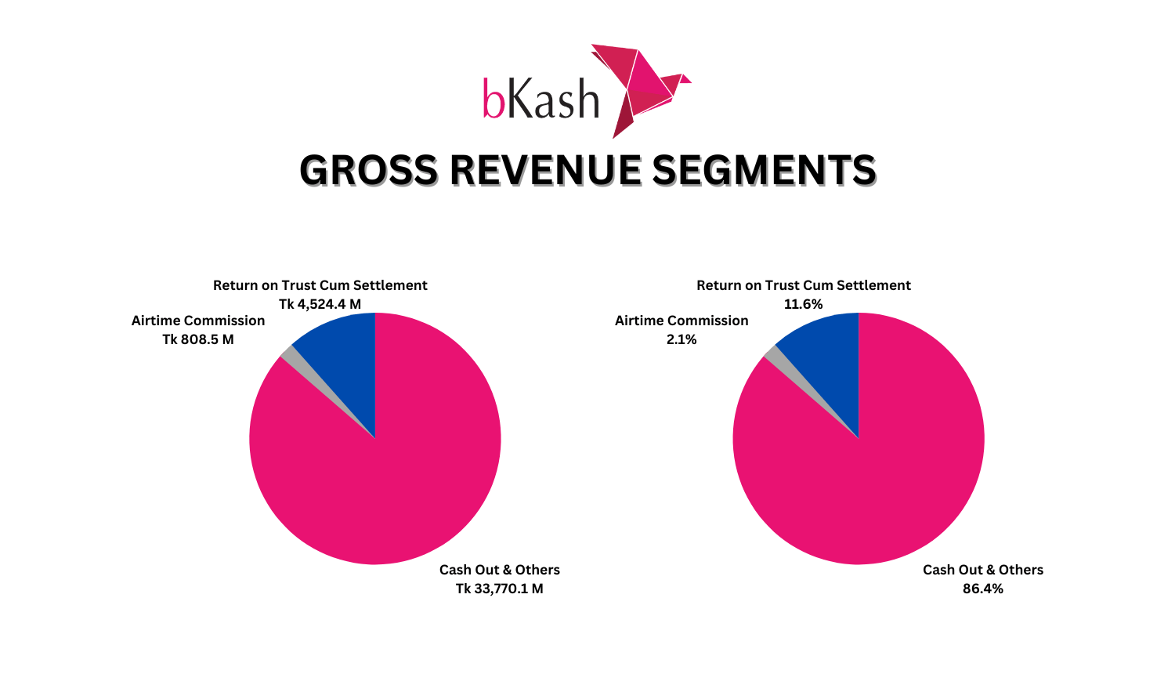
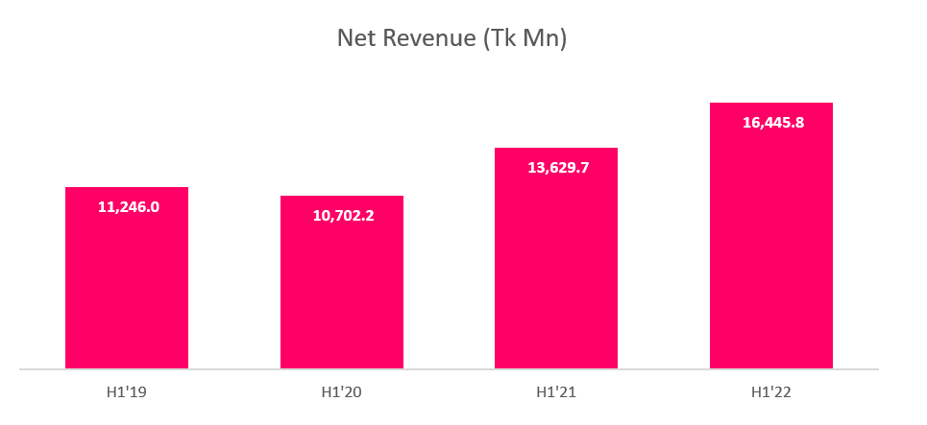
Growth Trajectory
bKash has seen exponential growth since its launch, becoming the largest mobile financial service in Bangladesh . Supported over 10 billion transactions since its inception.
Economic Impact: Promotes economic activity by facilitating easy access to money transfer services . Significant contributor to financial inclusion, especially in rural areas .
Financial Literacy : Offers educational programs to improve financial literacy among users, ensuring they understand the benefits of digital transactions.

Slide 5
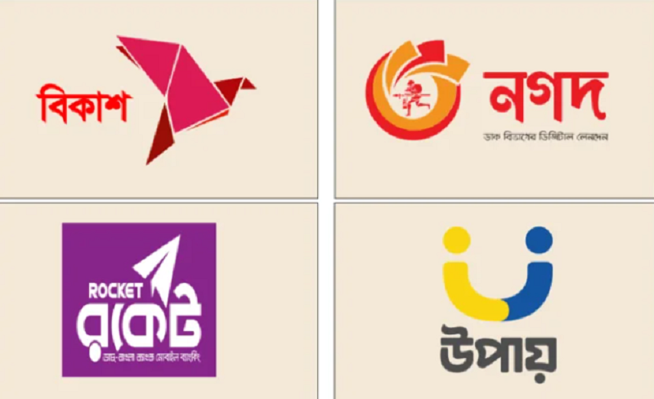
Challenges Faced by bKash
1. Competition:
Increasing competition from other mobile financial services (e.g., Nagad, Rocket).
2. Regulatory Challenges : Adhering to changing regulations from the Bangladesh Bank and government.
3. Security Concerns : Addressing concerns over fraud and cyber threats.
4. User Adoption : Encouraging less tech-savvy users to adopt digital transactions.

Slide 6

Future Outlook:
Plans to integrate more services, such as micro-loans and insurance, to enhance user experience . Commitment to further promoting financial literacy and inclusion.

Slide 7
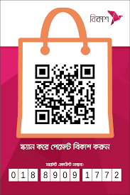
THANK YOU

